Slide 1
Valuation
Presented by: Renee Beaver, CPA
Tuesday, May 3, 2016

Slide 2
Initial Considerations
Is the purchase a purchase of interest or underlying assets?
One project or portfolio of projects?
Notes:
It is important to understand the distinction between purchasing the Partner interest in a LIHTC partnership vs. the underlying assets of a LIHTC partnership.
The General Partner has the right to future cash flow of the LIHTC partnership as outlined in the permanent documents of the partnership, such as the Partnership Agreement, Developer Fee Agreement, etc.

Slide 3
Calculating Value of Interest
Things to consider:
Project’s net operating income
Revenue projections
Operating expenses
Project liabilities
Cash waterfall
Notes:
There are many factors used in determining the value of the Partner interest in a real estate project:
Calculation of NOI – Can the property operate on its own without the need of refinancing/contributions?
Revenue projections – Is there a market advantage? (Percentage discount of LIHTC rent to achievable market rent) – Generally underwriting 10-20% gap. Historic data shows that rent has increased ~2.39% from 1999 through 2013. Generally 2% rent growth is reasonable, depending on the location of the project (state, metropolitan/rural, etc.). HUD Projects (hold harmless)?
Operating expenses – Consider: Location, utility structure, age/design/condition of project, tenancy, number of units, unit mix, type of property (market, LIHTC, HUD). Generally 3% expense growth is reasonable,
depending on location. Usually audited numbers are used in coming up with projections, as historical data is the best indicator. Reserves range from $250 – 500 per unit for older properties.
Calculation of liabilities – Is any debt expected to be forgiven? Deferred interest? Developer Fees owed? Can debt be refinanced?
GP Cash benefits – developer fee, preferred return, GP loans, management fees (generally not considered a benefit included in discounted cash flow analysis)

Slide 4
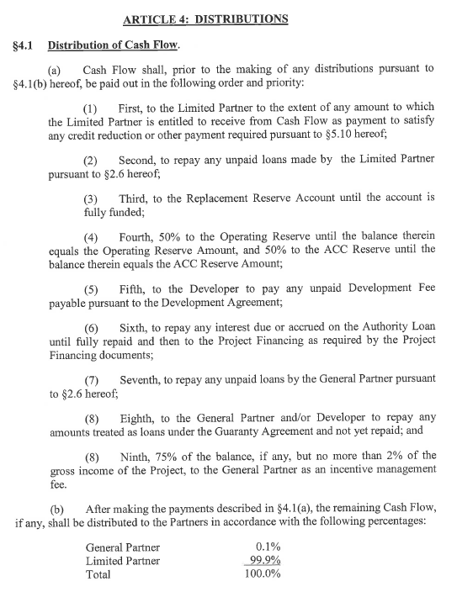
Sample Cash Waterfall - Annual
(5) Developer Fee
(7) Repay GP Loans
(8) Incentive Fee
Notes:
Let’s take a look at an example of a standard LIHTC annual cash waterfall.
As you can see, available cash is first to be used to cover any payments made by, or due to the Limited Partner, as expected.
Second, cash is used to fund reserves (another way for the Limited Partner to be reassured the project will not fail)
Next, payments are made on the developer fee, a direct benefit to the General Partner
Next to repay soft-debt loans
Next is to pay GP guarantees, as well as an incentive management fee to the General Partner.
Lastly, distributions are made pro-rata based on ownership percentage.

Slide 5
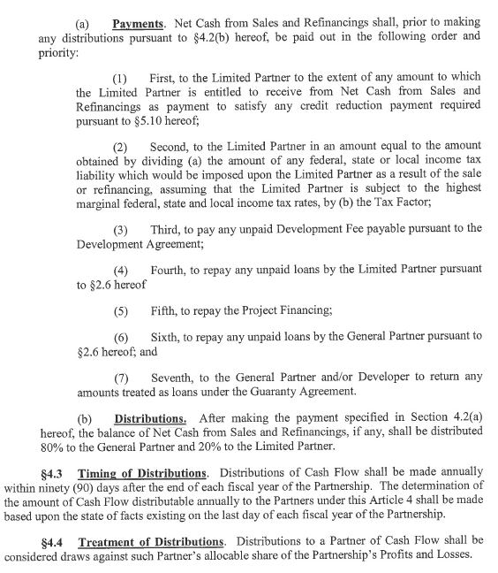
Sample Cash Waterfall – Capital Transaction
(3) Developer Fee
(6) Repay GP Loans
Distributed - 80/20
Notes:
Let’s take a look at an example of a standard LIHTC cash waterfall following capital transactions or refinancing.
As you can see, available cash is first to be used to cover any Limited Partner tax credit shortfalls.
Second, cash is used to pay the Limited Partner’s tax liability resulting from the transaction
Next, payments are made on the developer fee, a direct benefit to the General Partner
Next to repay loans
Next is to pay GP guarantees, as well as an incentive management fee to the General Partner.
Lastly, any amount left over is distributed 80% to the General Partner and 20% to the Limited Partner.

Slide 6
Documents you will need.
All prior tax returns (tax basis capital)
Most recent audited financial statement
Most recent internal financial statement
Partnership/Operating Agreement
All loan agreements (pre-payment?)
Restricted Covenant
Regulatory Agreement, HAP Contract

Slide 7
Novogradac Resources
Operating Expense Report
Valuation of GP Interests
Visit www.novoco.com

Slide 8
Questions?
Renee.Beaver@Novoco.com

