Slide 1
MID-EAST REGION ECONOMIC AND HOUSING TRENDS AND FORECASTS
Midwest Rural Housing Summit
May 3, 2016
Daniel J. Hogan, Director of Research
RED CAPITAL GROUP

Slide 2
AGENDA
Base Macroeconomic Outlook
State GDP, Payroll Employment and Personal income Trends and Forecasts
5-state Home Price Appreciation Rates and Forecasts
Review of Some of the Faster Growing Non-metropolitan Areas in the 5-state Region
Ohio Oil & Gas Industry Conditions and Outlook

Slide 3
Focus: Indiana, Kentucky, Michigan, Ohio and West Virginia Data: Personal Income Growth 2015, BEA

Slide 4
GDP Trends and Forecast Sources: Bureau of Economic Analysis, RED Capital Research Forecasts
Personal Consumption Expenditures, Industrial Production, Personal
Income and dPayroll growth down. Only dHPI positive predictive variable.

Slide 5
Payroll Employment Trends and Forecast Sources: Bureau of Labor Statistics, RED Capital Research Forecasts

Slide 6
Personal Income Trends and Forecast Sources: Bureau of Economic Analysis, RED Capital Research Forecasts

Slide 7
Regional Job Growth Performance Sources: Bureau of Labor Statistics, RED Capital Research Forecasts

Slide 8
Regional Job Growth Performance

Slide 9
Regional GDP Growth Performance Source: BEA

Slide 10
Regional GDP Growth Performance Source: BEA

Slide 11
Indiana Personal Income Trends and Forecast Sources: Bureau of Economic Analysis, RED Capital Research Forecasts
Critical Variable: Payroll Growth Rate T-6 (+)

Slide 12
Kentucky Personal Income Trends and Forecast Sources: Bureau of Economic Analysis, RED Capital Research Forecasts
Critical Variable: Industrial Production T-1 (-)

Slide 13
Michigan Personal Income Trends and Forecast Sources: Bureau of Economic Analysis, RED Capital Research Forecasts
Critical Variables: WTI (-) Baa yields (+)

Slide 14
Ohio Personal Income Trends and Forecast Sources: Bureau of Economic Analysis, RED Capital Research Forecasts
Critical Variables: dPayroll Growth Rate, WTI

Slide 15
West Virginia Personal Income Trends and Forecast Sources: Bureau of Economic Analysis, RED Capital Research Forecasts
Critical Variables: GDP (-), delta payroll growth (neutral)

Slide 16
Rankings for Income Growth
State | 1990 – 2015 Average | Rank | 2016 – 2020 Forecast | Rank
Indiana | 4.2% | 2 | 3.2% | 1
Kentucky | 4.6% | 1 | 3.0% | 2
Michigan | 3.6% | 5 | 2.6% | 4
Ohio | 3.8% | 4 | 2.5% | 5
West Virginia | 4.0% | 3 | 2.9% | 3
U.S.A. | 4.8% |  | 3.4%
Although the region still is likely to underperform the U.S. average, relative performance
Will be better than the 26-year historical average.

Slide 17
Indiana Payroll Employment Trends and Forecast Sources: Bureau of Labor Statistics, RED Capital Research Forecasts
Critical Variables: Negative constant, GDP (-) vs. 10-year UST yield (+)

Slide 18
Kentucky Payroll Employment Trends and Forecast Sources: Bureau of Labor Statistics, RED Capital Research Forecasts
Critical Variables: Positive constant

Slide 19
Michigan Payroll Employment Trends and Forecast Sources: Bureau of Labor Statistics, RED Capital Research Forecasts
Critical Variables: Positive constant, industrial production (+)

Slide 20
Ohio Payroll Employment Trends and Forecast Sources: Bureau of Labor Statistics, RED Capital Research Forecasts
Critical Variables: Positive constant, industrial production (+)

Slide 21
W.V. Payroll Employment Trends and Forecast Sources: Bureau of Labor Statistics, RED Capital Research Forecasts
Critical Variables: Coal (+) and Industrial Production (+) are statistically significant, both near term negatives.

Slide 22
Rankings for Job Growth Highest to Lowest Left to Right
Kentucky is best positioned to weather a coming slowdown due to strongest current momentum, highest positive constant and lowest statistical exposure to GDP & IP.

Slide 23
Kentucky Payroll Forecast Sources: BLS, RCR Forecasts

Slide 24
Michigan Payroll Forecast Sources: BLS, RCR Forecasts
Supported by state’s above average personal income growth and positive statistical correlation to the rate of change of U.S. payroll growth and neg. correlation to NGDP.

Slide 25
Ohio Payroll Forecast Sources: BLS, RCR Forecasts
Like Michigan, Ohio is supported by positive statistical correlation to the rate of change of U.S. payroll growth and neg. correlation to NGDP.

Slide 26
Indiana Payroll Forecast Sources: BLS, RCR Forecasts
Indiana benefits from positive correlation to home price appreciation and a negative correlation to systemic credit risk, but relatively underperforms during period when productivity rises.

Slide 27
West Virginia Payroll Forecast Sources: BLS, RCR Forecasts
West Virginia is highly correlated to the pace of US payroll and Industrial Production growth and to the global price of coal. None will help in a slow growth domestic environment.

Slide 28
House Price Index Trends and Forecast Sources: Federal Housing Finance Agency HPI, RED Capital Research Forecasts
MICHIGAN us_inc (-) Baa (+)
KENTUCKY inc (+)
INDIANA
OHIO / WEST VIRGINIA pr inc coal prices

Slide 29
5-State Region Micropolitan Area Gazelles Overview Sources: Census Bureau
Population Growth 2010-2015 | Indiana | Kentucky | Michigan | Ohio | West Virginia | Total
=> 2% | 3 | 5 | 1 | 0 | 0 | 9
0% - 2% | 8 | 1 | 4 | 5 | 1 | 19
<0% | 13 | 1 | 6 | 22 | 2 | 44
Total | 24 | 7 | 11 | 27 | 3 | 72

Slide 30
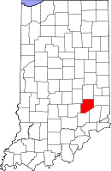
Micropolitan Area Gazelles: Greensburg, Indiana (Decatur County/SE Indiana) Sources: Census Bureau, Bureau of Labor Statistics
 | 2010 | 2015 | % Chg | 2014 | % Chg
Population | 25,791 | 26,521 | 2.8% | 26,511 | 0.0%
Payrolls | 11,181 | 13,520 | 20.9% | 13,489 | 0.2%
Growth Drivers: Manufacturing (Engineering intensive, auto) Interstate-74 linking Cincinnati/Indianapolis

Slide 31
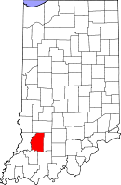
Micropolitan Area Gazelles: Washington, Indiana (Daviess County/SW Indiana) Sources: Census Bureau, Bureau of Labor Statistics
 | 2010 | 2015 | % Chg | 2014 | % Chg
Population | 31,744 | 32,906 | 3.7% | 32,745 | 0.5%
Payrolls | 10,441 | 11,246 | 7.7% | 10,980 | 1.1%
Growth Drivers: Machinery and homebuilding products Lake / Lifestyle tourism Access to I-69 Indianapolis/Louisville/St. Louis

Slide 32
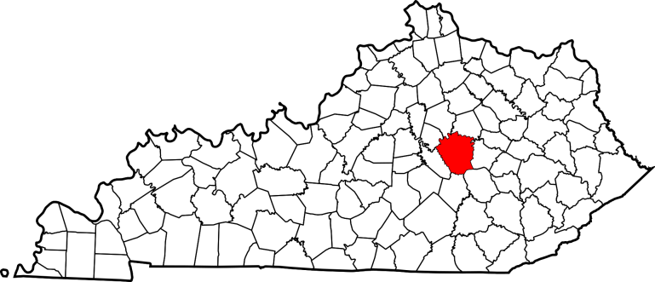
Micropolitan Area Gazelles: Richmond-Berea, Kentucky (Madison, Rockcastle Counties/Bluegrass Country) Sources: Census Bureau, Bureau of Labor Statistics
 | 2010 | 2015 | % Chg | 2014 | % Chg
Population | 100,262 | 104,766 | 4.5% | 103,522 | 1.2%
Payrolls | 32,921 | 37,041 | 12.5% | 36,884 | 1.0%
Growth Drivers: Higher Education (EKU, Berea College) Spillover from fast growing Lexington MSA

Slide 33
Micropolitan Area Gazelles: Mt. Sterling, Kentucky Bath, Menifee, Montgomery Counties/Bluegrass Country Sources: Census Bureau, Bureau of Labor Statistics
 | 2010 | 2015 | % Chg | 2014 | % Chg
Population | 44,522 | 46,222 | 3.8% | 45,834 | 0.8%
Payrolls | 12,676 | 13,625 | 7.4% | 13,162 | 3.5%
Growth Drivers: Proximity to Lexington Rural community cost advantages Access to large city amenities

Slide 34
Micropolitan Area Gazelles: Traverse City, Michigan (Benzie, Grand Traverse, Kalkaska, Leelanau Counties/Lake Michigan Beach Area) Sources: Census Bureau, Bureau of Labor Statistics
 | 2010 | 2015 | % Chg | 2014 | % Chg
Population | 143,315 | 148,334 | 3.5% | 147,563 | 0.5%
Payrolls | 56,838 | 62,464 | 9.9% | 61,422 | 1.7%
Economic Drivers: Family/sporting tourism Financial services Small business development Higher Education (WMU, CMU branches)

Slide 35
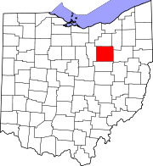
Micropolitan Area Gazelles: Wooster, Ohio (Wayne County, OH Sources: Census Bureau, Bureau of Labor Statistics
 | 2010 | 2015 | % Chg | 2014 | % Chg
Population | 22,422 | 23,137 | 3.1% | 22,854 | 1.2%
Payrolls | 41,622 | 45,279 | 8.8% | 44,253 | 1.0%
Growth Drivers: Consumer Food production Higher Education: College of Wooster Business expansions/4th ranked Site Selection

Slide 36
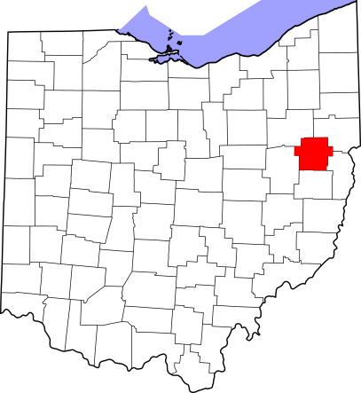
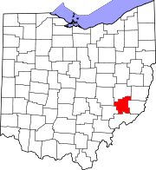
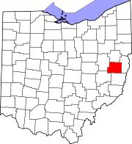
Oil & Gas Country: Carroll, Harrison, Noble Counties Sources: Census Bureau, Bureau of Labor Statistics
Carroll County
 | 2010 | 2015 | % Chg | 2014 | % Chg
Population | 28,825 | 27,811 | -3.5% | 28,209 | -1.4%
Payrolls | 5,486 | 6,874 | 25.3% | 6,766 | 1.6%
Economic Drivers: Oil & Gas Industry
Noble County
 | 2010 | 2015 | % Chg | 2014 | % Chg
Population | 14,645 | 14,326 | -2.2% | 14,377 | -0.4%
Payrolls | 2,975 | 3,156 | 6.1% | 3,261 | -3.2%
Economic Drivers: Oil & Gas Industry
Harrison County
 | 2010 | 2015 | % Chg | 2014 | % Chg
Population | 15,864 | 15,450 | -2.6% | 15,567 | -0.8%
Payrolls | 3,275 | 3,868 | 18.1% | 4,068 | -4.9%
Economic Drivers: Oil & Gas Industry

Slide 37
Ohio Oil & Gas Industry Sources: Independent Petroleum Association of America
Marcellus Shale (mostly dry gas)
Utica Shale (dry gas,
condensates, some crude)

Slide 38
Ohio Oil Gas & Coal Mining Payrolls Sources: BLS

Slide 39
Ohio Oil & Gas Production Sources: Ohio Division of Oil & Gas Resources
Gas expressed in thousand cubic feet (mcf) measurements, oil in millions of barrels.

Slide 40
Industry Conditions and Outlook
The Ohio O&G industry is at an early stage
Last year production increased at fastest rate of any U.S. shale oil and gas play
May be the most economically advantageous natural gas field in America due to:
Size
Cost of extraction
Proximity to residential and industrial users
Quality and concentration of condensates like ethane
But sharply lower prices have radically altered the landscape

Slide 41
Oil, Gas & Coal Prices Sources: Federal Reserve St. Louis, RCR Forecasts
Gas expressed in thousand cubic feet (mcf) measurements, oil in millions of barrels.

Slide 42
Industry Conditions and Outlook Cont.
But sharply lower prices have radically altered the landscape
Henry Hub Prices dropped to $2.43/btu last year, a decline of -41% from 2014 and the lowest in 16 years.
Prices now so low that the cost of separating previously prized condensates to form dry gas offsets profit that can be derived from the sale of dry and liquid gas products
Drillers have reduced exploration to minimum levels required to maintain existing fields and meet legal obligations under previously negotiated leases
Active rig count declined from 49 to 15 over 2015

Slide 43
Industry Outlook
The near term outlook is cloudy as pricing is expected to remain under supply pressure indefinitely.
But the intermediate term outlook remains promising
The principal benefit to the state of Ohio remains the job and revenue growth that will accompany mid-stream (pipeline) and end user (gas fired electric power and distillate cracking plants) that ultimately will be constructed to take advantage of the quality, diversity and volume of the Utica and Marcellus shale output
Cracking plants and utilities remain only in the early planning stages
Time horizons run from 5- to 10-years.
Long-term benefit to region in cheaper, more diversified sources of energy for residential, utility and industrial users.

Slide 44
Thanks, lets move on to Andrew and the rural housing market conditions …

Slide 45
Large Metro Apartment Occupancy Performance and Forecasts Sources: Reis Histories and RCR Forecasts

Slide 46
Large Metro Apartment Effective Rent Performance and Forecasts Sources: Reis Histories and RCR Forecasts

